Slide 1
Applications of Information and Communication Technologies
Rabail Asghar
Lecturer (Computer Science)
COMSATS University Islamabad, Lahore Campus

Slide 2
Topics to cover
Control Flow Statements

Slide 3
Control Flow Statements
The statements inside your source files are generally executed from top to bottom, in the order that they appear. Control flow statements, however, break up the flow of execution by employing decision making/conditioning, looping, and transferring control, enabling your program to execute particular blocks of code.

Slide 4
Control Flow Statements
The control flow statements are divided into three parts:-
Conditional statements
Iterative statements
Transfer statements

Slide 5
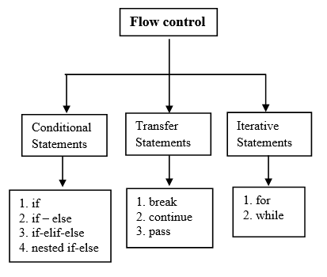
Control Flow Statements

Slide 6
1-Conditional statements
Conditional statements are a fundamental concept in programming that allows us to make decisions based on certain conditions.
In simple terms, a program can check whether a condition is true or false and then take different actions based on that result.

Slide 7
1-Conditional statements
Why Conditional Statements Are Important?
In business analytics, you often need to check conditions like:
"Is the sales total higher than $5000?"
"Did the customer buy more than 10 items?"
"Is the employee's performance score above 80?"

Slide 8
1-Conditional statements
Types of conditional statements:-
if statement
If-else statement
If-elif-else statement
Nested if-else

Slide 9
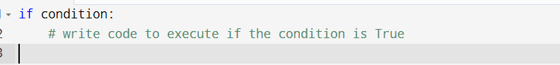
If statement
The if statement is used to check whether a condition is True.
If the condition is true, the block of code inside the if statement is executed.
Syntax:

Slide 10
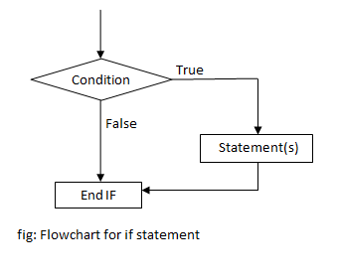
if statement

Slide 11
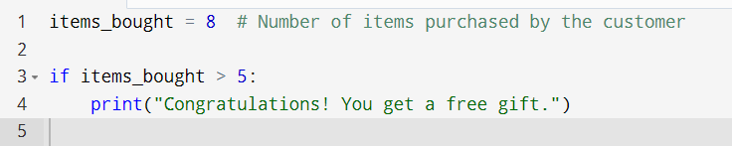
If statement
Example:
Imagine you're running a promotion in your store where customers get a free gift if they buy more than 5 items.

Slide 12
If statement
Explanation:
Here, the condition items_bought > 5 is checked. If the customer buys more than 5 items, the message "Congratulations! You get a free gift." will be printed.

Slide 13

If-else statement
It is used to execute one block of code if a condition is True, and a different block if the condition is False.
Syntax:

Slide 14
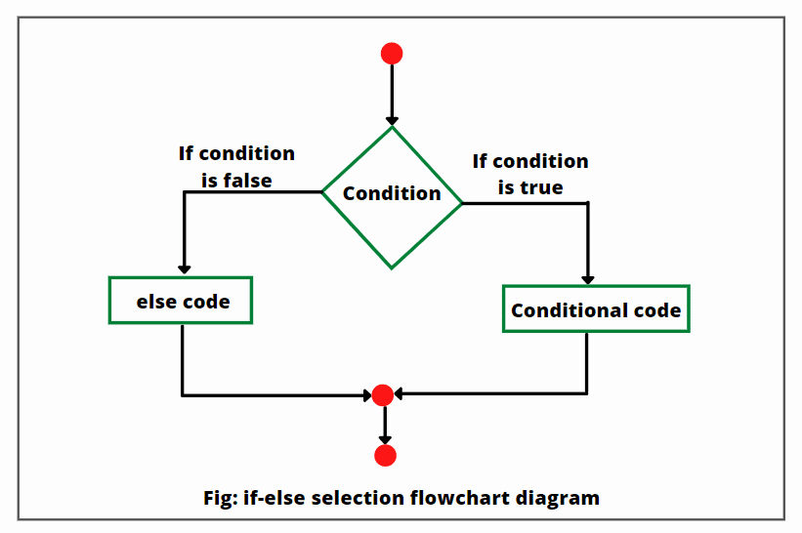
If-else statement

Slide 15
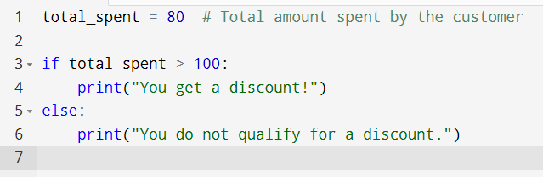
If-else statement
Example:
Consider a scenario where a customer is eligible for a discount only if they spend more than $100.

Slide 16
If-else statement
Explanation:
The program checks whether the total amount spent is greater than $100. If the condition is true, it prints "You get a discount!".
Otherwise, it prints "You do not qualify for a discount."

Slide 17
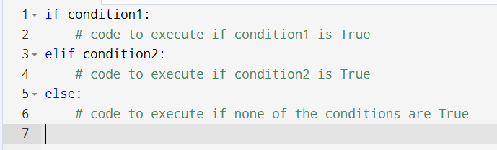
If-elif-else statement
To check multiple conditions, if-elif-else statements are used.
Different conditions and response is accordingly.
Syntax:

Slide 18
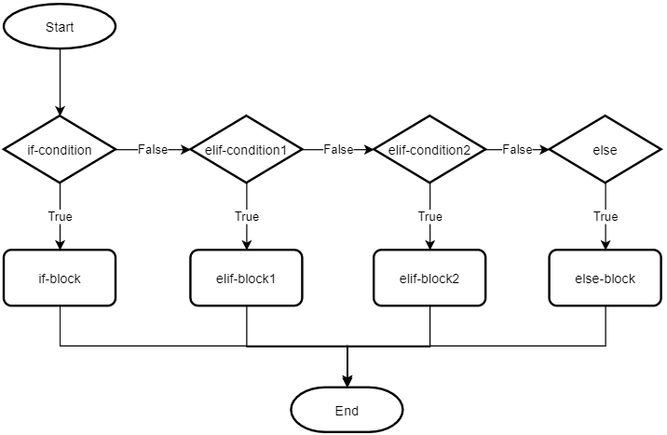
If-elif-else statement

Slide 19
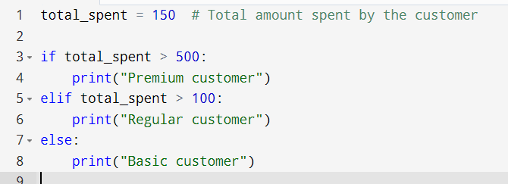
If-elif-else statement
Example:
Consider a scenario to categorize a sale based on how much the customer spends

Slide 20
If-elif-else statement
Explanation:
The program first checks if the customer spent more than $500. If true, it prints "Premium customer". If not, it checks if the amount is greater than $100, printing "Regular customer". If both conditions are false, it prints "Basic customer"

Slide 21
Nested if-else statement
-An if-else statement inside another if-else statement.
-Use to check multiple conditions based on previous ones.
-Nested if-else helps in situations where certain decisions lead to additional conditions being checked.
-Useful in complex decision-making processes in business.

Slide 22
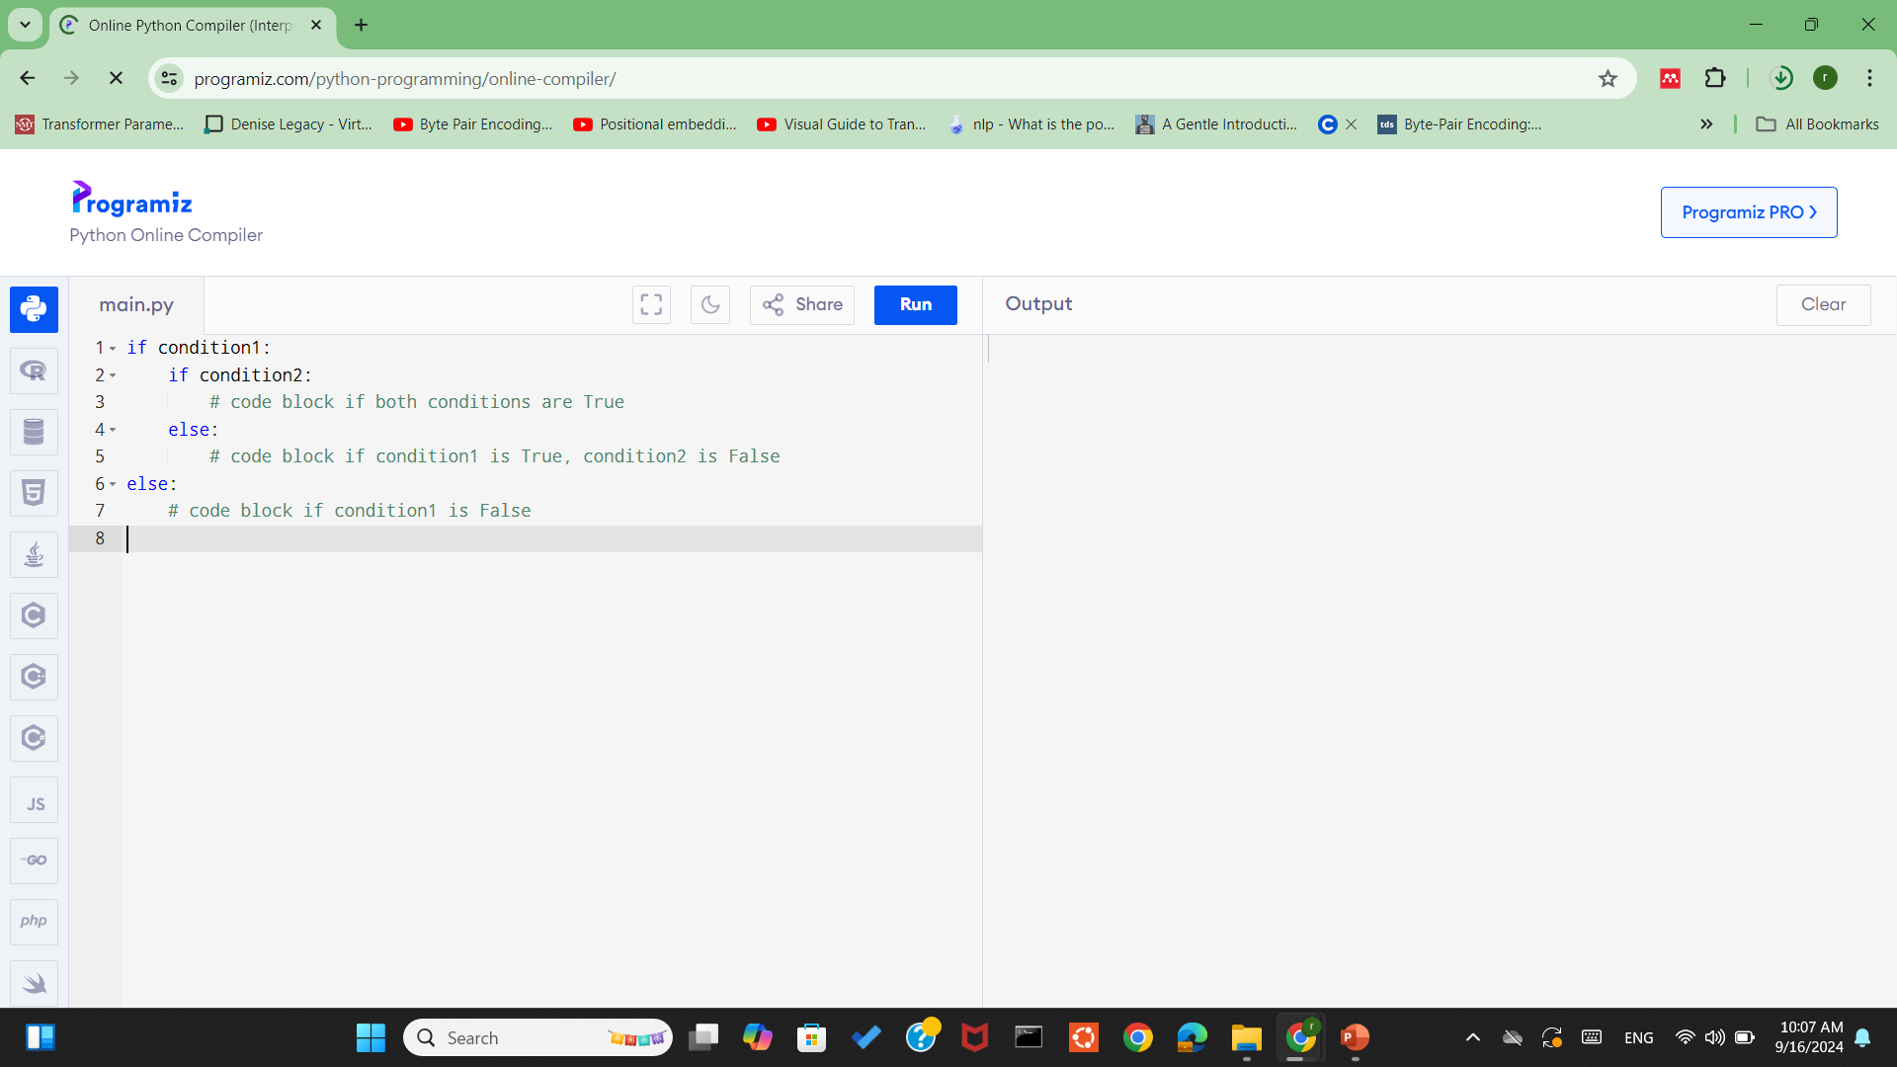
Nested if-else statement
Syntax:

Slide 23
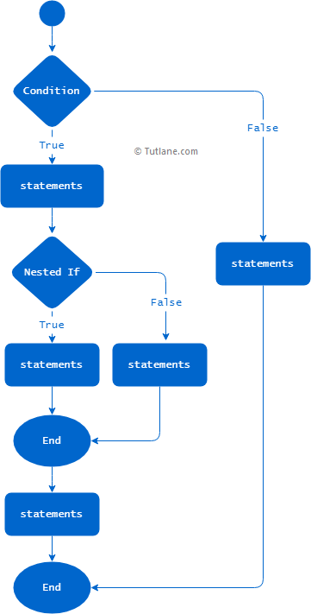
Nested if-else statement

Slide 24
Nested if-else statement
Example:
Evaluate sales performance and offer additional bonuses based on two conditions:
Sales above 100 units are eligible for bonuses.
If sales are above 100 units and customer ratings are above 4, give a bigger bonus.

Slide 25
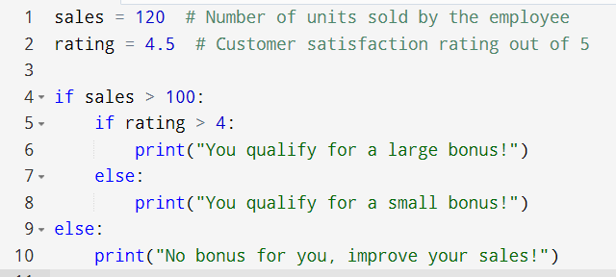
Nested if-else statement

Slide 26
Nested if-else statement
Explanation:
Step 1: The outer if checks whether the employee’s sales are greater than 100.
Step 2: If this condition is True, the inner if checks the customer satisfaction rating. If the rating is greater than 4, the employee gets a large bonus. If the rating is 4 or lower, the employee gets a small bonus.
Step 3: If the outer if condition (sales > 100) is False, the employee does not qualify for any bonus.

Slide 27
Example: Movie Ticket Pricing
Ask the user for their age. If the person is under 5, the ticket is free. If the person is between 5 and 18, the ticket costs 10 dollars. If the person is over 18, the ticket costs 15 dollars. Display the final price.

Slide 28
Example: Bus Fare Based on Age and Student Status
Scenario: Ask the user for their age and whether they are a student (yes or no).
If the user is under 18:
If they are a student → print "Fare is Rs. 20"
Else → print "Fare is Rs. 30"
If the user is 18 or older:
If they are a student → print "Fare is Rs. 40"
Else → print "Fare is Rs. 50"

